Slide 1
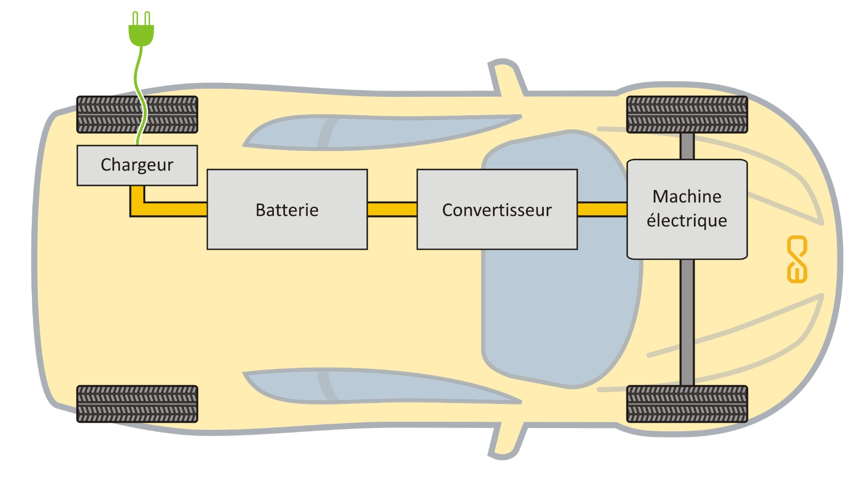
BEV, battery electric vehicle
Source: Educam HEV training

Slide 2
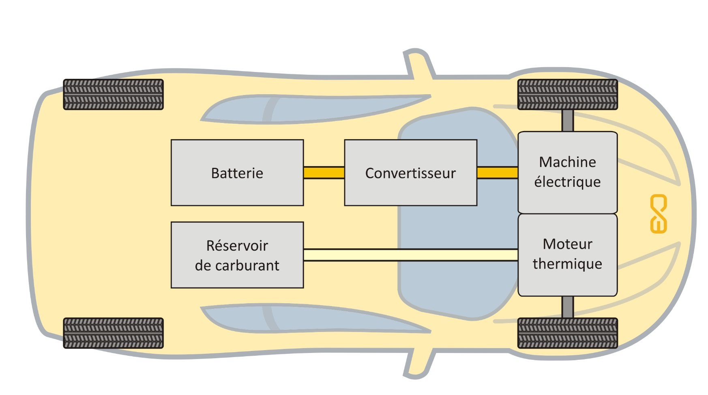
HEV, hybrid electric vehicle
1 – 2 kwh
Source: Educam HEV training

Slide 3
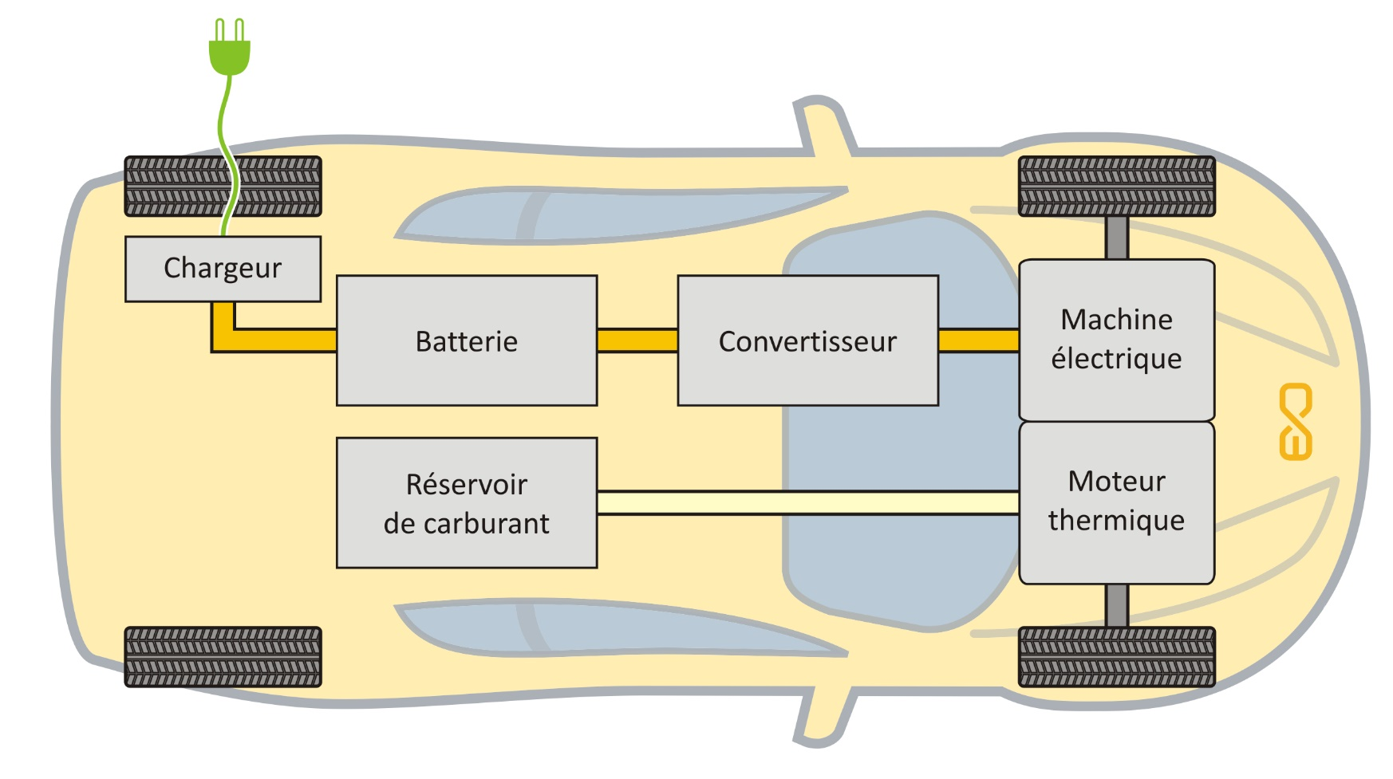
PHEV, plug-in HEV
10 – 20 kwh
Source: Educam HEV training

Slide 4
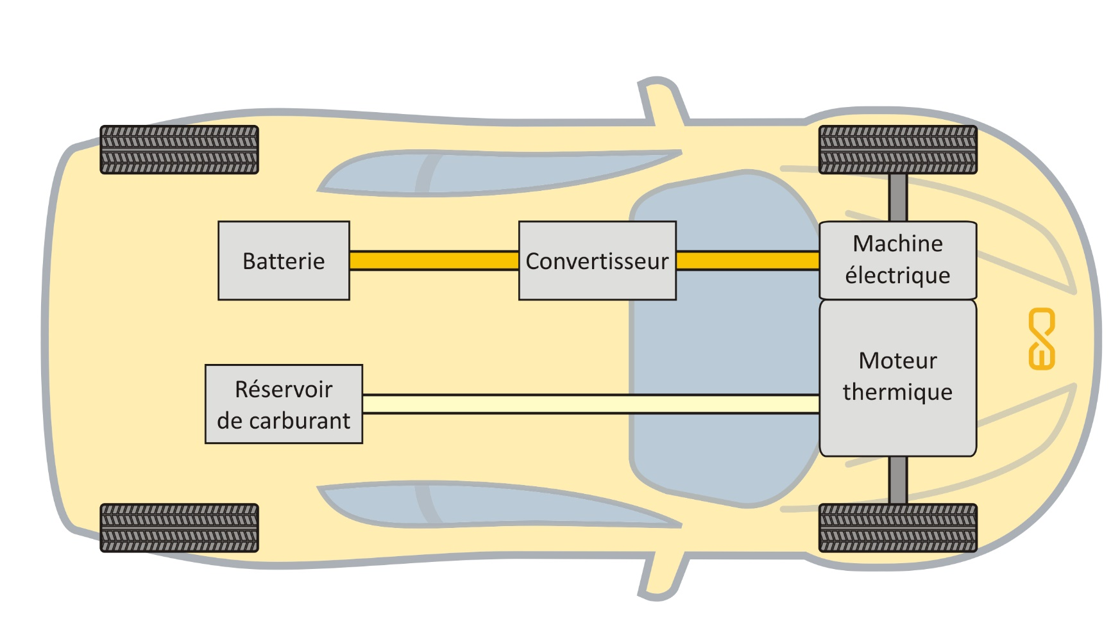
Parallel Hybrid
Source: Educam HEV training

Slide 5
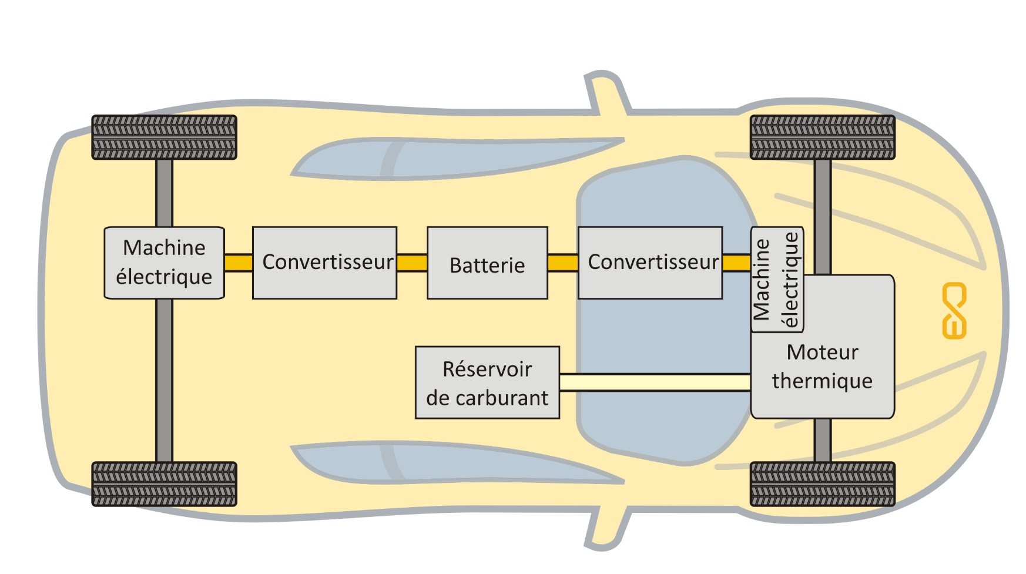
Parallel Hybrid 4x4
Source: Educam HEV training

Slide 6
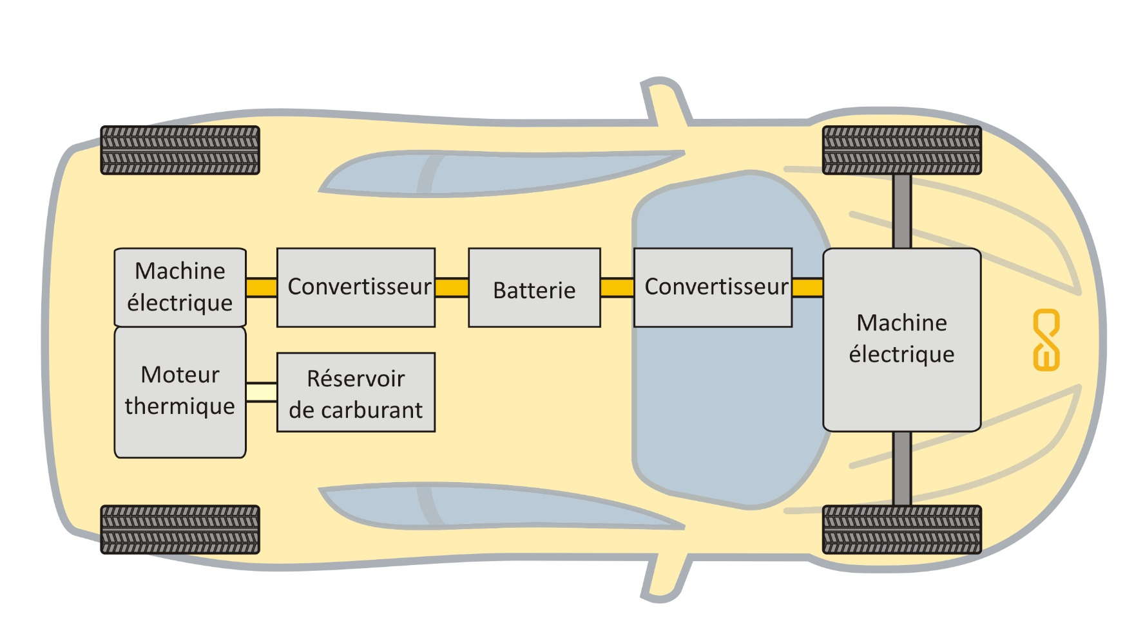
Series Hybride
Source: Educam HEV training

Slide 7
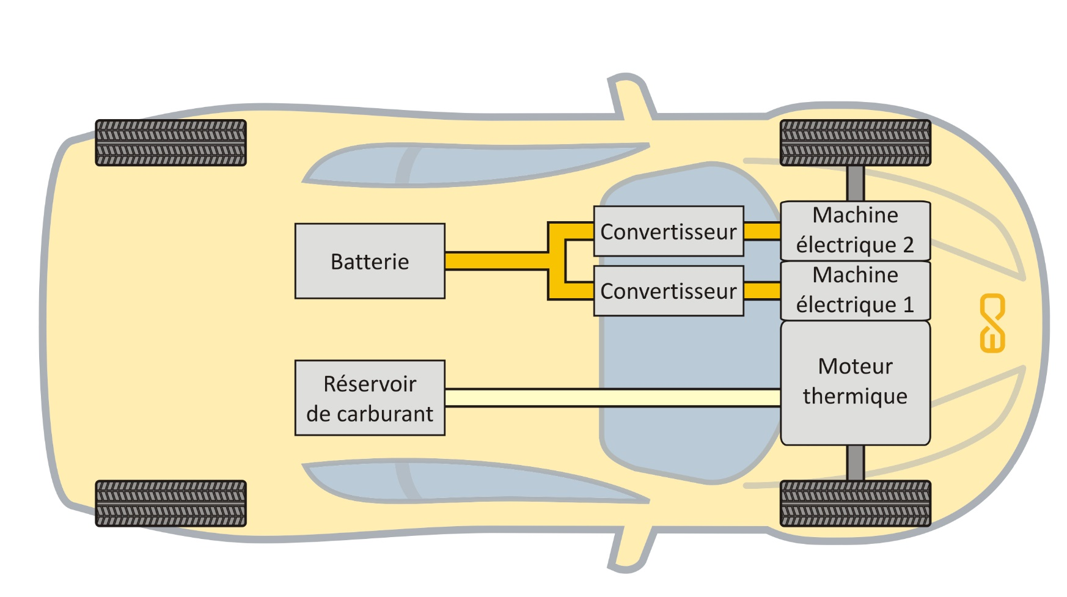
Combined Hybrid
Source: Educam HEV training

Slide 8



Hybrid model 1: SIMPLIFIED « energy recovery in PLUG IN Hybrid »
Time, distance, speed (t)
If hybrid ? A general idea
P <0 & SOC <1
P> P_{nom} & SOC >0,3
acceleration
Forces: rolling, grading, drag
MIN of Energy abs:
MIN of Energy:
(SOC - 1) * BATT_{E}
(SOC – 0,3) * BATT_{E}
P * Δ time
P * Δ time
POWER
Energy = MIN
Energy_{fuel} = (P * Δt) - MIN
ENERGY
SOC = SOC - $\frac{ENERGY}{BATTE}$
SOC = SOC - $\frac{MIN}{BATTE}$
Fuel, CO2
Do not count negative energy !
BRAKING
BOOST
BATT_{E} = MAX Energy content ; State Of Charge in % ; P power

Slide 9


Hybrid model 2: SIMPLIFIED « we consider low energy supercaps »
Time, distance, speed (t)
If BATT_{E} <<< Energy to accel or brake the car
P <= 0
P > 0
acceleration
BATT_{V} =
BATT_{V} =
Forces: rolling, grading, drag
(SOC - 1) * BATT_{E}
(SOC – 0,3) * BATT_{E}
POWER
Energy = BATT_{V}
Energy_{f} = (P * Δt) - BATT_{V}
ENERGY
SOC = SOC - $\frac{BATTV}{BATTE}$ < 1
SOC = SOC - $\frac{BATTV}{BATTE}$ > 0,3
Fuel, CO2
Do not count negative energy !
BRAKING
BOOST
BATT_{V} = Energy variable

Slide 10


Hybrid model 2: SIMPLIFIED « we consider high energy batteries »
Time, distance, speed (t)
If BATT_{E} >>> Energy to accel or brake the car
V1
P <= 0
P > 0
acceleration
P * Δ time
P * Δ time
BATT_{V} =
BATT_{V} =
Forces: rolling, grading, drag
FACT = 0,9 (P MOTOR / P)
FACT = 0,9 (P MOTOR / P)
POWER
Eco driving
Energy = FACT * BATT_{V}
Energy_{f} = (1 – FACT) * BATT_{V}
ENERGY
SOC = SOC - $\frac{FACT∗ BATTV}{BATTE}$
SOC = SOC - $\frac{FACT∗ BATTV}{BATTE}$
< 1
> 0,3
Fuel, CO2
Do not count negative energy !
BRAKING
BOOST
BATT_{V} = Energy variable
No influence of SOC, to be improved…

Slide 11
Hybrid model 2: SIMPLIFIED « energy recovery in PLUG IN Hybrid »
Time, distance, speed (t)
If BATT_{E} >>> Energy to accel or brake the car
V2
P <= 0
P > 0
acceleration
P * Δ time
P * Δ time
BATT_{V} =
BATT_{V} =
Forces: rolling, grading, drag
IF SOC<1; FACT = 0,9 (P MOTOR / P)
ELSE FACT = 0
IF SOC>0,3; FACT = 0,9 (P MOTOR / P)
ELSE FACT = 0
POWER
Energy = FACT * BATT_{V}
Energy = (1 – FACT) * BATT_{V}
ENERGY
SOC = SOC - $\frac{FACT∗ BATTV}{BATTE}$
SOC = SOC - $\frac{FACT∗ BATTV}{BATTE}$
< 1
> 0,3
Fuel, CO2
Do not count negative energy !
BRAKING
BOOST
BATT_{V} = Energy variable
SOC depleting, to be improved…

Slide 12
Hybrid model 3: SIMPLIFIED « energy recovery in Full Hybrid, non Plug In »
Time, distance, speed (t)
If BATT_{E} >>> Energy to accel or brake the car
V3
P <= 0
P > 0
acceleration
P * Δ time
P * Δ time
BATT_{V} =
BATT_{V} =
Forces: rolling, grading, drag
IF SOC<1; FACT = 0,9 (P MOTOR / P)
ELSE FACT = 0
IF SOC>0,3; FACT = 0,9 (P MOTOR / P)
ELSE FACT = 0
POWER
Energy = FACT * BATT_{V}
Energy = (1 – FACT) * BATT_{V}
ENERGY
SOC = SOC - $\frac{FACT∗ BATTV}{BATTE}$
SOC = SOC - $\frac{FACT∗ BATTV}{BATTE}$
< 1
> 0,3
Fuel, CO2
+ Energy = (SOC_{START} – SOC_{END}) * BATT_{E} with MAX engine efficiency and SOC_{END} = SOC_{START}
Do not count negative energy !
Add one fictive line in the travel !

Slide 13
Summary:
A calculation model, not a simulation model
Easy calculation of CO2 for ICE or Electric car
But difficult to calibrate the calculation by relevant ICE efficiency models
Possibility to introduce hybrid car !
Simplify the model when using excel
Good visibility of results, of influences of parameters
Ideal before making a simulation with a program
Mandatory to use a programming language to introduce decisions in the model !

Slide 14
Examples of typical fuel consumptions
Engine type | NEDC | Francorchamps
Gasoline « old » | ~9,0 l/100 | ~15 l/100
Electric | ~14 kwh/100 | ~30 kwh/100
Hybrid | ~8,0 l/100 ^{(*)} | ~10,0 l/100
Plug in hybrid | ~3,0 l/100 | ~5,5 l/100
^{(*)} I have decided to recharge the battery with gasoline energy at the end of the test. It is not necessary following the standard method.
The main interest being to compare models and results or evaluate the influence of major parameters…

Slide 15
Examples of associated CO2 emissions in gr/km
Engine type | NEDC | Francorchamps
Gasoline « old » | ~ 200 | ~ 340
Electric | ~ 60 | ~ 100
Hybrid | ~ 172,8^{(*)} | ~ 260
Plug in hybrid | ~ 70 | ~ 130
^{(*)} I have decided to recharge the battery with gasoline energy at the end of the test. It is not necessary following the standard method.
The main interest being to compare models and results or evaluate the influence of major parameters…

